Slide 1
Displaying Text

Slide 2

Overview
Using headings
Working with block and inline elements Managing text breaking and white space Displaying reference text

Slide 3
Headings
Heading 1
Heading 2
Heading 3
Heading 4
Heading 5
Denote sections of the document
H1 is the primary heading for the document
- Should only appear once per page
H2 – H6 are secondary headings
Heading 6

Slide 4
Block vs. Inline Elements
Block elements (e.g. div)
Containers to group other elements May contain block or inline elements
Inline elements (e.g. span)
Container for text
May contain other inline elements

Slide 5
<span>Some plain text <span id=“inner”>with inline text</span> included</span>
Nesting inline elements

Slide 6
Nesting Within Block Elements
<div>
<p>A paragraph explaining coffee.</p>
<p>A paragraph about the company.</p>
</div>
Nesting Block Elements
<p>This is a block with <span>inline text</span> within it.</p>
Nesting Inline Elements

Slide 7
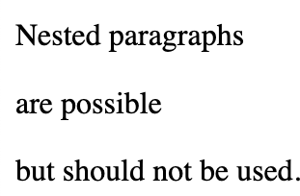
Nested paragraphs<p>are possible </p>
but should not be used.
<p>
</p>
You can nest paragraphs but you should not

Slide 8
Text Breaking and Whitespace
<pre></pre>
<br />
<hr />
&nbsp;
&lt; &gt;

Slide 9
Reference Text
<sup></sup>
<sub></sub>
<cite></cite>
<abbr></abbr>
<code></code>
<samp></samp>
<kbd></kbd>
<var></var>
<blockquote>
</blockquote>
<q></q>

Slide 10
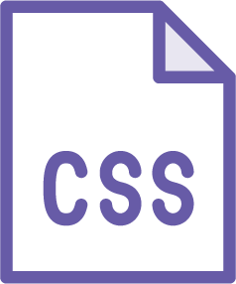
Formatting Elements
Holdovers from early days for basic formatting (bold & italics e.g.)

Slide 11
Our cups are labeled with
<span class="important">Warning: Coffee is hot!</span> to help keep you safe.
Styling Text

Slide 12
<style>
span.important {
color:red;
}
</style>
Styling Text

Slide 13
Semantic
Relating to meaning in language or logic

Slide 14
Elements with More Semantic Meaning
div
Simple structure of document content
Generic container Meaning derived from other attributes
section, article, footer, nav
Specific document component Well defined meaning

Slide 15
Summary
Text semantics
Text formatting Special types of text

